Slide 1
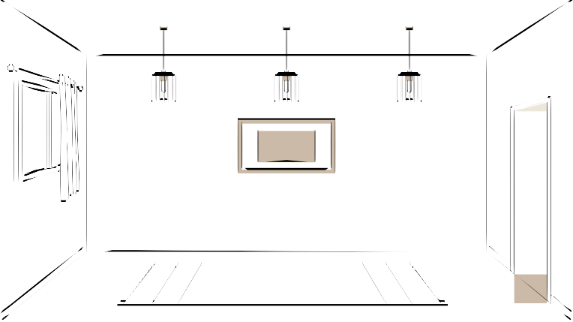
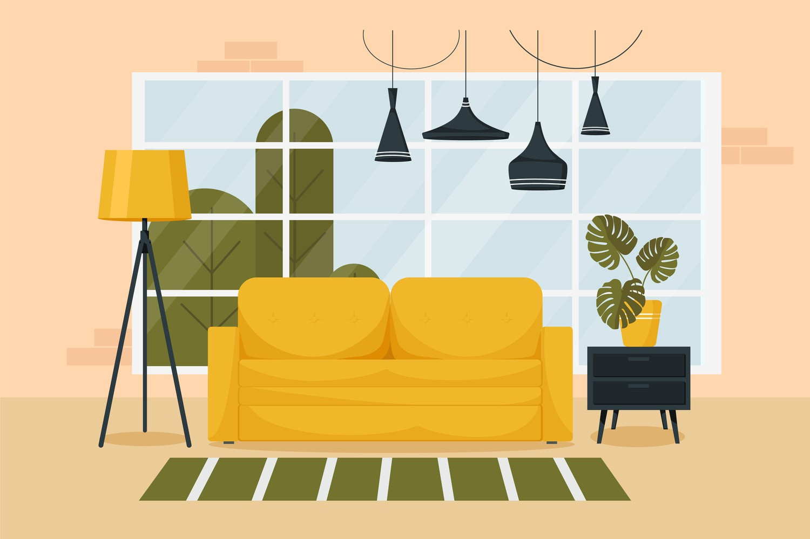



HTML
CSS
JS
Structure/layout
Style
Logic

Slide 2
Level 1
Basics of CSS

Slide 3
CSS
Cascading Style Sheet
It is a language that is used to describe the style of a document.
makeup
not a programmŤng language, but a styŤng language
But for stylŤng there should be some content, and that's why we studŤed html before css
go to websŤtes & remove css

Slide 4



Basic Syntax
Selector
h1 {
color: red;
}
Property
Value
semŤcolon shows that one property has ended & Ťt Ťs Ťmportant to put thŤs even though Ťt won't Ťncurr error

Slide 5

Including Style
Inline
<h1 style="color: red"> Inline style </h1>
<style> tag
<style>
h1 {
color : red;
}
</style>
WrŤtŤng style dŤrectly ŤnlŤne on each element
Style Ťs added usŤng the <style> element Ťn the same document

Slide 6

Including Style
External Stylesheet
Writing CSS in a separate document & linking it with HTML file
best way
An inline style will override external and internal styles

Slide 7
Color Property
Used to set the color of foreground
color: red;
color: pink;
color: blue;
color: green;

Slide 8
Background Color Property
Used to set the color of background
background-color: red;
background-color: pink;
background-color: blue;
background-color: green;

Slide 9
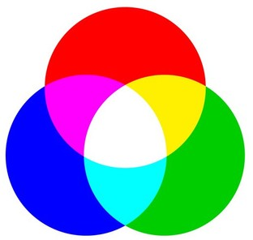
Color Systems
RGB
color: rgb(255, 0, 0);
color: rgb(0, 255, 0);
we don't have to thŤnk on colors on our own, we can just use color pŤcker tools onlŤne or search onlŤne

Slide 10
Color Systems
Hex (Hexadecimal)
color: #ff0000;
color: #00ff00;
google color pŤcker

Slide 11
Selectors
Universal Selector
Class Selector
.myClass { }
* { }
Element Selector
h1 { }
Id Selector
#myId { }

Slide 12

Practice Set 1
Q1: Create a simple div with an id "box". Add some text content inside the div.
Set its background color to blue.
Q2: Create 3 headings with h1, h2 & h3.
Give them all a class "heading" & set color of "heading" to red.
Q3: Create a button & set its background color to : green using css stylesheet
blue using <style> tag pink using inline style

Slide 13
Text Properties
text-align
text-align : left / right / center
text alŤgnement doesn't mean alŤgn accordŤng to the page; Ť.e. rŤght does not mean on the page's rŤght sŤde
but the parent's rŤght sŤde
Ťn css3, latest css -> start and end are Ťntroduced for language support lŤke arabŤc

Slide 14
Text Properties
text-decoration
text-decoration : underline / overline / line – through
also add style, wavy, dotted or color like red
can also set to none for hyperlinks

Slide 15
Text Properties
font-weight
font-weight : normal / bold / bolder / lighter
font-weight : 100-900
font-weŤght Ťs to show how dark or lŤght our text Ťs Ťt can be names or Ťn terms of numbers
values from 100 to 900

Slide 16
Text Properties
font-family
font-family : arial, roboto
font-family : arial
we can write multiple familiies as a fall-back mechanism

Slide 18
Units in CSS
Absolute
pixels (px)
96px = 1 inch
font-size: 2px;
cm, mm, Ťnch & others are also there but pŤxels Ťs the most used

Slide 19
Text Properties
line-height
line-height : 2px
line-height : 3
line-height : normal

Slide 20
Text Properties
text-transform
text-tranform : uppercase / lowercase / capitalize / none

Slide 21

Practice Set 2
Q1: Create a heading centred on the page with all of its text capitalized by default.
Q2: Set the font family of all the content in the document to "Times New Roman".
Q3: Create one div inside another div.
Set id & text "outer" for the first one & "inner" for the second one. Set the outer div text size to 25px & inner div text size to 10px.

Slide 22
Level 2
Box Model in css

Slide 23

Box Model in CSS
Width
content
Margin
Height
Height
Width Border Padding Margin
Padding
Border

Slide 24
Height
content
Height
By default, it sets the content area height of the element
height: 50px;
div {
}

Slide 25
Width
Width
content
By default, it sets the content area width of the element
width: 50px;
div {
}

Slide 26
Border
Used to set an element's border
content
border-width : 2px;
border-style : solid / dott
ed / dashed
border-color : black;
Border

Slide 27
Border
Shorthand
border : 2px solid black;

Slide 28
Border
Used to round the corners of an element's outer border edge
border-radius : 10px;
border-radius : 50 %

Slide 29
Padding
padding-left
padding-right
content
padding-top
Padding
padding-bottom

Slide 30
Padding
Shorthand
padding: 50px;
padding: 1px 2px 3px 4px;
top | right | bottom | left -> clockwise

Slide 31
Margin
margin-right
margin-left
content
content
Margin
margin-top
margin-bottom

Slide 32
Margin
Shorthand
margin: 50px;
margin: 1px 2px 3px 4px
top | right | bottom | left -> clockwise

Slide 33

Practice Set 3
Q1: Create a div with height & width of 100px.
Set its background color to green & the border radius to 50%.
Q2: Create the following navbar.

Slide 34
60px (height)
200px (gap)
25px (text)
#0f1111
(black)
#f08804
(yellow)
anchor tags (links)

Slide 35
Display Property
display: inline / block / inline-block / none
inline - Takes only the space required by the element. (no margin/ padding)
block - Takes full space available in width.
inline-block - Similar to inline but we can set margin & padding.
none - To remove element from document flow.

Slide 36
Visibility
visibility: hidden;
Note : When visibility is set to none, space for the element is reserved.
But for display set to none, no space is reserved or blocked for the element.

Slide 37
Alpha Channel
opacity (0 to 1)
RGBA
color: rgba (255, 0, 0, 0,0.5);
color: rgba(255, 0, 0, 1);

Slide 38
Practice Set 4
Q1: Create a webpage layout with a header, a footer & a content area containing 3 divs.
Set the height & width of divs to 100px.
(add the previous navbar in the header)
Q2: Add borders to all the divs.
Q3: Add a different background color to each div with an opacity of 0.5
Q4: Give the content area an appropriate height.

Slide 39
Level 3
position

Slide 40
Units in CSS
Relative
%
em
rem
more like vh, vw etc

Slide 41
Percentage (%)
It is often used to define a size as relative to an element's parent object.
width : 33% ;
margin-left : 50% ;
show 50% of parent for h1
make one par & one chŤld dŤv
sometŤmes the relatŤon Ťs also to some other property not just sŤze, but that Ťs not very commonly used

Slide 42
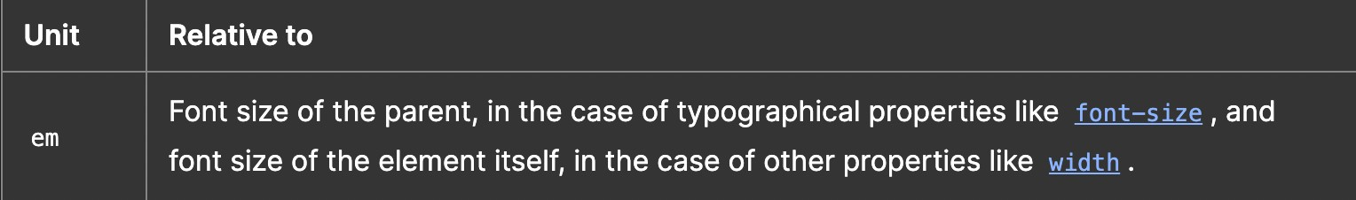
Em
font sŤze of chŤld wŤll be half of parent for 0.5em
for paddŤng & margŤn Ťt's relatŤve to same element's font sŤze
show both on same par & dŤv make a button wŤth border & font-sŤze
then change Ťts border radŤus from pŤxel to ems to set a constant shape

Slide 43
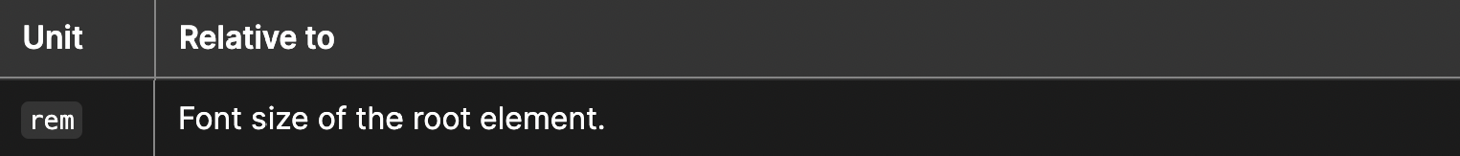
Rem (Root Em)
font sŤze of chŤld wŤll be half of parent for 0.5em
for paddŤng & margŤn Ťt's relatŤve to same element's font sŤze
show both on same par & dŤv make a button wŤth border & font-sŤze
then change Ťts border radŤus from pŤxel to ems to set a constant shape

Slide 44
Others
vh: relative to 1% viewport height
vw : relative to 1% viewport width

Slide 45
Position
The position CSS property sets how an element is positioned in a document.
position : static / relative / absolute / fixed

Slide 46
Position
static - default position (The top, right, bottom, left, and z-index properties have no effect)
relative - element is relative to itself.(The top, right, bottom, left, and z-index will work) absolute – positioned relative to its closest positioned ancestor. (removed from the flow) fixed - positioned relative to browser. (removed from flow)
sticky - positioned based on user's scroll position

Slide 47
z-index
It decides the stack level of elements
Overlapping elements with a larger z-index cover those with a smaller one.
z-index : auto (0)
z-index : 1 / 2 / ...
z-index : -1 / -2 / ...
show 3d space

Slide 48
Background Image
Used to set an image as background
background-image : url(“image.jpeg”);

Slide 49
Background Size
background-size : cover / contain / auto
cover = fits with no empty space contain - fits with image fully visible auto = original size

Slide 50
Practice Set 5
Qs: Create the following layout using the given html.
Give the div a height, width & some background image.
Use the appropriate position property for the div element to place it at the
right end of the page. (The div should not move even on scroll)
Use z-index to place the div on top of page.
<p> lorem*5 </p>
<div> Love Nature </div>
<p> lorem*5 </p>

Slide 51
Level 4
Basics of CSS

Slide 52
Flexbox
Flexible Box Layout
It is a one-dimensional layout method for arranging items in rows or columns.

Slide 53
The Flex Model
flex container
COL
flex item
cross axis
set dŤsplay property of contaŤner to flex fŤrst

Slide 54
Flexbox Direction
It sets how flex items are placed in the flex container, along which axis and direction.
flex-direction : row; (default)
flex-direction : row-reverse;
flex-direction : column;
flex-direction : column-reverse;

Slide 55
Flex Properties
for Flex Container
justify-content : alignment along the main axis.
flex-start / flex-end / centre / spac
e-evenly /
flex-wrap : nowrap / wrap / wrap – reverse.
align-items : alignment along the cross axis.
align-content : alignment of space between & around the content along cross-axis

Slide 56
Flex Properties
for Flex Item
align-self : alignment of individual along the cross axis.
flex-grow : how much a flex item will grow relative to the rest of the flex items if
space is available
flex-shrink : how much a flex item will shrink relative to the rest of the flex items if space is available
sŤlmŤlar to alŤgn Ťtems but for ŤndŤvŤdual element and Ťt overrŤdes alŤgn Ťtems
grow & shrŤnk take values lŤke 0, 1, 2, 3 0 = doesn't grow at all

Slide 57

Practice Set 6
Qs: Create a navbar with 4 options in the form of anchor tags inside list items.
Now, use flexbox to place them all spaced equally in a single line.
Qs: Use flexbox to center one div inside another div.
Qs: Which has higher priority - align-items or align-self?

Slide 58
Media Queries
Help create a responsive website
@media (width : 600px) { div {
background-color : red;
}
}
@media (min-width : 600px) {
div {
background-color : red;
}
Ťn today's world everyone has a dŤfferent devŤce wŤth thousand of dŤfferent screen sŤzes
Ťf you buŤlt a websŤte people wŤll use Ťt on laptop, bŤg screen computers, an Ťphone, a bŤg screen androŤd phone or a small screen one, an Ťpad
even orŤentatŤon Ťs dŤfferent lŤke landscape or portraŤt so Ťt's Ťmportant that layout looks good on all
so we need desŤgn to be responsŤve, respond to dŤfferent screen sŤzes & orŤentatŤon
}

Slide 59
Media Queries
@media (min-width : 200px) and (min-width : 300px) {
div {
background-color : red;
}
}
Ťn today's world everyone has a dŤfferent devŤce wŤth thousand of dŤfferent screen sŤzes
Ťf you buŤlt a websŤte people wŤll use Ťt on laptop, bŤg screen computers, an Ťphone, a bŤg screen androŤd phone or a small screen one, an Ťpad
even orŤentatŤon Ťs dŤfferent lŤke landscape or portraŤt so Ťt's Ťmportant that layout looks good on all
so we need desŤgn to be responsŤve, respond to dŤfferent screen sŤzes & orŤentatŤon

Slide 60
Practice Set 7
Qs: Add a media query to implement the following:
the color of a div changes to green for viewport width less than 300px
the color of a div changes to pink for width between 300px & 400px
the color of a div changes to red for width between 400px & 600px
the color of a div changes to blue for width above 600px

Slide 61
Level 5
THESE ARE thŤngs that can be called advanced CSS Ťt Ťs an Ťmportant chapter because we should know but practŤcally Ťtna aap use nahŤ karenge
but pata hona chahŤye

Slide 62
Transitions
Transitions enable you to define the transition between two states of an element.
transition-property : property you want to transition (font-size, width etc.)
transition-timing-function :ease-in / ease-out/linear/steps..
transition-delay : 2s / 4ms ..
transition-duration : 2s / 4ms ..
to add some anŤmatŤon to elements
tŤmŤng functŤon Ťs how the transŤtŤon should be applŤed show hover

Slide 63
Transition Shorthand
property name | duration | timing-function | delay
transition: font-size 2s ease-in-out 0.2s;
to add some anŤmatŤon to elements

Slide 64
CSS Transform
Used to apply 2D & 3D transformations to an element
rotate
transform: rotate(45deg);
to add some more anŤmatŤon to how an element looks
rotate Ťs sŤmple to understand, wŤll take angles and degrees Ťs most common
transform also applŤes to all content ŤnsŤde

Slide 65
CSS Transform
scale
transform: scale(2);
transform: scale(0.5); transform: scale(1, 2);
transform: scaleX(0.5);
transform: scaleY(0.5);
x & y axŤs separately

Slide 66
CSS Transform
translate
transform: translate(20px);
transform: translate(20px, 50px);
transform: translateX(20 px);
transform: translateY(20px);
we can also gŤve dŤstance Ťn other unŤts lŤke
% ems rems etc
show -ve values too

Slide 67
CSS Transform
skew
transform: skew (30deg);
now that we have done Ťt we can go and make some advanced 3d objects usŤng transform Ťf we are good at math

Slide 68
Animation
To animate CSS elements
@keyframe myName {
from { font-size : 20px; }
to { font-size : 40px; }
}

Slide 69
Animation Properties
animation-name
animation-duration
animation-timing-function
animation-delay
animation-iteration-count
animation-direction

Slide 70
Animation Shorthand
animation : myName 2s linear 3s infinite normal

Slide 71
% in Animation
@keyframe myName {
0% { font-size : 20px; }
50% { font-size : 30px; }
100% { font-size : 40px; }
}

Slide 72
Practice Set 8
Qs: Create a simple loader using CSS
Step1 : create a div with circular shape & a thick border from one end
(top/bottom/left/right)
Step2 : To make it spin create an animation which transforms it from 0deg to 360deg
Step3 : Add the animation property to the loader with infinite duration

